Slide 1
SS ZG 526: Distributed Computing
Global State Recording
Chittaranjan Hota
Professor, Dept. of Computer Sc. & Information Systems
BITS, Pilani Hyderabad Campus, Hyderabad
hota@hyderabad.bits-pilani.ac.in

Slide 2

Snapshot algorithms for FIFO channels
Chandy-Lamport algorithm
The Chandy-Lamport algorithm uses a control message, called a marker whose role in a FIFO system is to separate messages in the channels.
After a site has recorded its snapshot, it sends a marker, along all of its outgoing channels before sending out any more messages.
A marker separates the messages in the channel into those to be included in the snapshot from those not to be recorded in the snapshot.
A process must record its snapshot no later than when it receives a marker on any of its incoming channels.
Birla Institute of Technology and Science, Pilani (Deemed University)

Slide 3
Chandy-Lamport algorithm continued…
The algorithm can be initiated by any process by executing the “Marker Sending Rule” by which it records its local state and sends a marker on each outgoing channel.
A process executes the “Marker Receiving Rule” on receiving a marker. If the process has not yet recorded its local state, it records the state of the channel on which the marker is received as empty and executes the “Marker Sending Rule” to record its local state.
The algorithm terminates after each process has received a marker on all of its incoming channels.
All the local snapshots get disseminated to all other processes and all the processes can determine the global state.
Birla Institute of Technology and Science, Pilani (Deemed University)

Slide 4
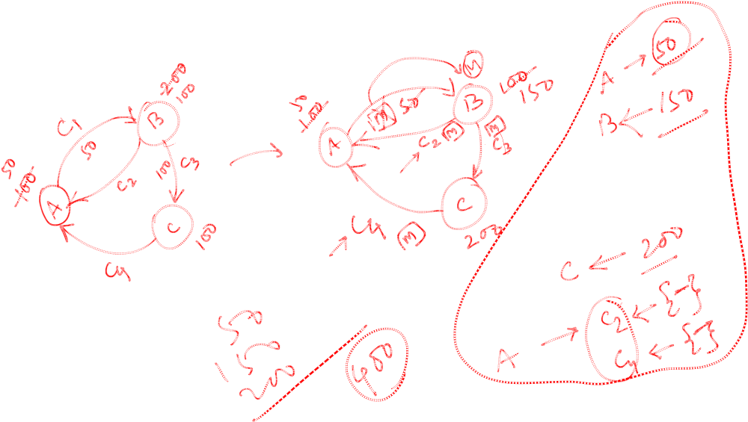
State Recording Example
Birla Institute of Technology and Science, Pilani (Deemed University)

Slide 5
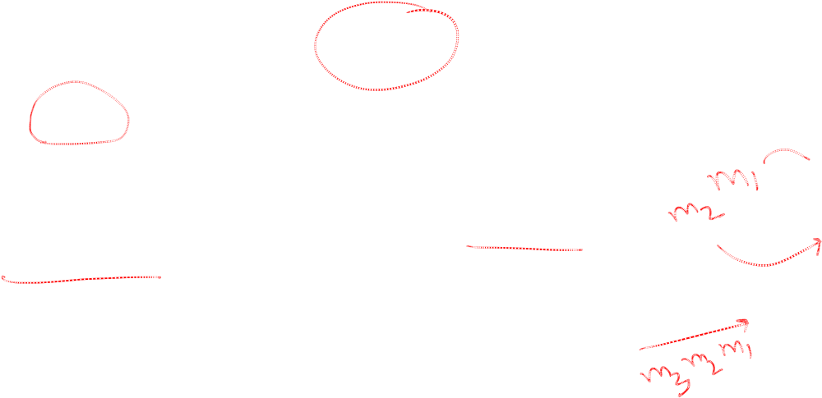
Global state recording for non-FIFO channels
A marker (like in Chandy-Lamport) cannot be used to delineate messages.
Here, either some degree of inhibition or piggybacking of control information on computation messages is to be used to capture out-of-sequence messages.
Birla Institute of Technology and Science, Pilani (Deemed University)

Slide 6
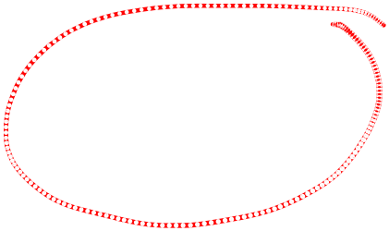
Lai-Yang algorithm for non-FIFO channels
The Lai-Yang algorithm uses a coloring scheme on computation messages that works as follows:
1 Every process is initially white and turns red while taking a snapshot. The equivalent of the “Marker Sending Rule” is executed when a process turns red.
2 Every message sent by a white (red) process is colored white (red).
3 Thus, a white (red) message is a message that was sent before (after) the sender of that message recorded its local snapshot.
4 Every white process takes its snapshot at its convenience, but no later than the instant it receives a red message.
Birla Institute of Technology and Science, Pilani (Deemed University)

Slide 7
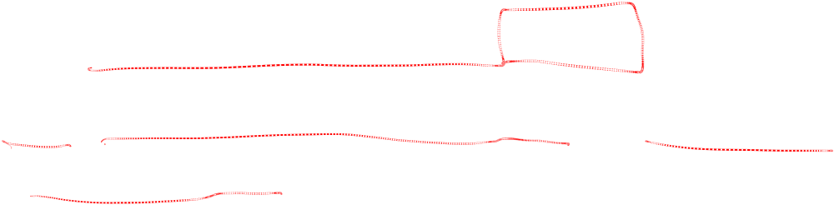
Lai-Yang algorithm continued…
4 Every white process records a history of all white messages sent or received by it along each channel.
5 When a process turns red, it sends these histories along with its snapshot to the initiator process that collects the global snapshot.
6 The initiator process evaluates transit (LS_{i}, LS_{j}) to compute the state of a channel C_{ij} as given below:
SC_{ij}= white messages sent by P_{i} on C_{ij} − white messages received by P_{j} on C_{ij}
Birla Institute of Technology and Science, Pilani (Deemed University)

Slide 8
Next module
Causal ordering of messages
Birla Institute of Technology and Science, Pilani (Deemed University)

